Slide 1
Lecture 12 Graphs
Department of Computer Science
Hofstra University
Acknowledgement: Lecture slides based on UofW Course on Data Structures

Slide 2
Inter-data Relationships
Arrays
Trees
Graphs
Elements only store pure data, no connection info
Only relationship between data is order
Elements store data and connection info
Directional relationships between nodes; limited connections
Elements AND connections can store data
Relationships dictate structure; huge freedom with connections
C
B
0 | 1 | 2
A | B | C
B
A
C
A

Slide 3
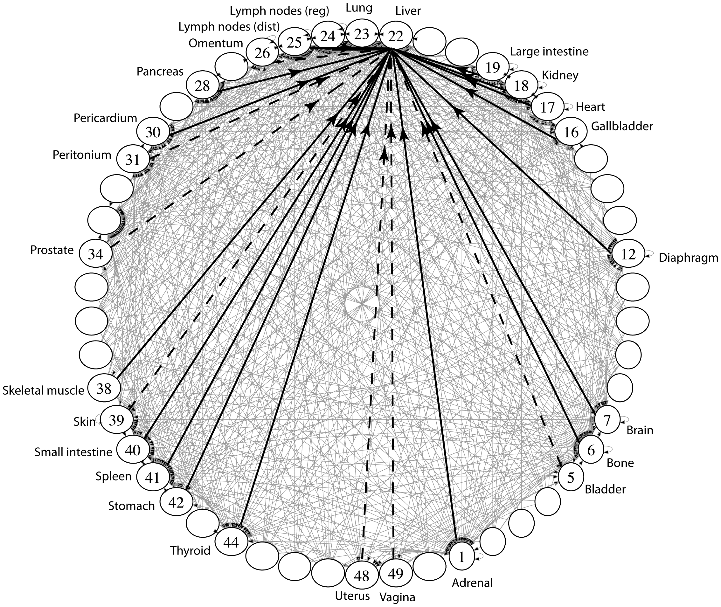
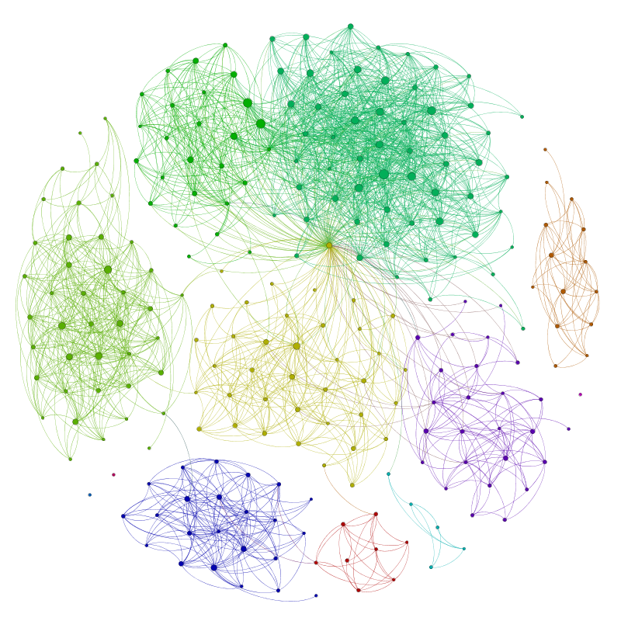
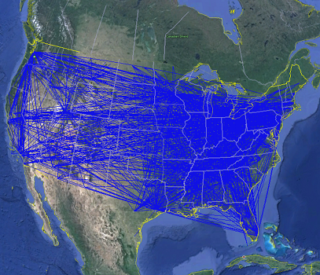
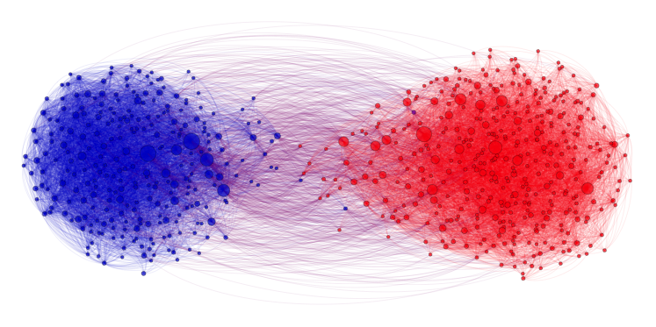
Applications
Physical Maps
Airline maps
Vertices are airports, edges are flight paths
Traffic
Vertices are addresses, edges are streets
Relationships
Social media graphs
Vertices are accounts, edges are follower relationships
Traffic
Vertices are classes, edges are usage
Influence
Biology
Vertices are cancer cell desinations, edges are migration paths
Related topics
Web Page Ranking
Vertices are web pages, edges are hyperlinks
Wikipedia
Vertices are articles, edges are links
And so many more!!
www.allthingsgraphed.com

Slide 4
Graph: Formal Definition
G
A graph is defined by a pair of sets G = (V, E) where…
V is a set of vertices
A vertex or “node” is a data entity
V = { A, B, C, D, E, F, G, H }
E is a set of edges
An edge is a connection between two vertices
E = { (A, B), (A, C), (A, D), (A, H),
(C, B), (B, D), (D, E), (D, F),
(F, G), (G, H)}
H
F
A
D
C
B
E

Slide 5
Graph Terminology
Undirected Graph:
Graph Direction
Undirected graph – edges have no direction and are two-way
V = { Karen, Jim, Pam }
E = { (Jim, Pam), (Jim, Karen) } inferred (Karen, Jim) and (Pam, Jim)
Directed graphs – edges have direction and are thus one-way
V = { Gunther, Rachel, Ross }
E = { (Gunther, Rachel), (Rachel, Ross), (Ross, Rachel) }
Degree of a Vertex
Degree – the number of edges connected to that vertex
Karen : 1, Jim : 1, Pam : 1
In-degree – the number of directed edges that point to a vertex
Gunther : 0, Rachel : 2, Ross : 1
Out-degree – the number of directed edges that start at a vertex
Gunther : 1, Rachel : 1, Ross : 1
Karen
Jim
Directed Graph:
Pam
Rachel
Gunther
Ross

Slide 6
More Graph Terminology
j
f
g
Two vertices are connected if there is a path between them
If all the vertices are connected, we say the graph is connected
A directed graph is weakly connected if replacing every directed edge with an undirected edge results in a connected graph
A directed graph is strongly connected if a directed path exists between every pair of vertices
The number of edges leaving a vertex is its degree
A path is a sequence of vertices connected by edges
A simple path is a path without repeated vertices
A cycle is a path whose first and last vertices are the same
A graph with a cycle is cyclic
e
not connected
d
b
c
a
i
p
n
connected
o
m
i
p
n
o
m

Slide 7
Directed vs Undirected; Acyclic vs Cyclic
Directed:
Undirected:
b
b
e
Acyclic:
a
d
a
d
c
c
b
b
Cyclic:
a
d
a
d
c
c

Slide 8
Labeled and Weighted Graphs
Vertex Labels
Vertex & Edge Labels
Edge Labels
b
e
c
2
c
5
a
d
a
d
a
d
1
3
b
b
c
4
Numeric Edge Labels (Edge Weights)
3
1
1
2

Slide 9
Multi-Variable Analysis
So far, we thought of everything as being in terms of some single argument “n”
With graphs, we need to consider:
n (or |V|): total number of vertices (sometimes written as V)
m (or |E|): total number of edges (sometimes written as E)
deg(u): degree of node u (how many outgoing edges it has)

Slide 10
Adjacency Matrix
4
0
1
5
6
In an adjacency matrix a[u][v] is 1 if there is an edge (u,v), and 0 otherwise.
Worst-case Time Complexity (|V| = n, |E| = m):
Add Edge:
Remove Edge:
Check edge exists from (u,v):
Get out-neighbors of u:
Get in-neighbors of u:
Space Complexity:
More suitable for dense graphs
2
3
 | 0 | 1 | 2 | 3 | 4 | 5 | 6
0 | 0 | 1 | 1 | 0 | 0 | 0 | 0
1 | 1 | 0 | 0 | 1 | 0 | 0 | 0
2 | 1 | 0 | 0 | 1 | 0 | 0 | 0
3 | 0 | 1 | 1 | 0 | 0 | 1 | 0
4 | 0 | 0 | 0 | 0 | 0 | 1 | 0
5 | 0 | 0 | 0 | 1 | 1 | 0 | 0
6 | 0 | 0 | 0 | 0 | 0 | 0 | 0
O(1)
O(1)
O(1)
O(n)
O(n)
O(n²)
For an undirected graph, adjacency matrix is symmetric w.r.t diagonal line. A node u’s out-neighbors are the same as its in-neighbors
Notes:
It is usual to write |V| = n and |E| = m, though sometimes we’ll abuse notation and just use V and E.
Adjacency Matrices take more space, why would you use them?
For dense graphs (where m is close to n²), the running times will be close
And the constant factors can be much better for matrices than for lists

Slide 11
Adjacency List
B
A
In an adjacency matrix a[u][v] is 1 if there is an edge (u,v), and 0 otherwise.
Worst-case Time Complexity (|V| = n, |E| = m):
Add Edge:
Remove Edge:
Check edge exists from (u,v):
Get outneighbors of u:
Get inneighbors of u:
Space Complexity:
More suitable for sparse graphs
C
D
Linked Lists
0
1
2
3
O(1)
A
B
C
O(deg(u))
B
O(deg (u))
O(deg(u))
C
B
D
O(n + m)
O(n + m)
D
A

Slide 12
Adjacency List
B
In an adjacency matrix a[u][v] is 1 if there is an edge (u,v), and 0 otherwise.
Worst-case Time Complexity (assuming a good hash function so all hash table operations are O(1)) (|V| = n, |E| = m):
Add Edge:
Remove Edge:
Check edge exists from (u,v):
Get outneighbors of u:
Get inneighbors of u:
Space Complexity:
A
C
D
Hash Tables
0 | 1 | 2 | 3 | 4
0
1
2
3
O(1)
A
B
C
O(1)
B
O(1)
0 | 1 | 2 | 3 | 4
O(deg(u) )
C
B
D
O(n)
0 | 1 | 2 | 3 | 4
D
A
O(n + m)
Notes:
For this class, unless we say otherwise, we’ll assume the hash tables operations on graphs are all O(1)
Because you can probably control the keys
Unless we say otherwise, assume we’re using the hash table approach

Slide 13
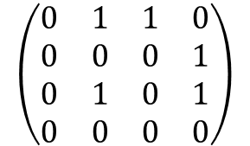
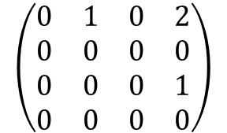
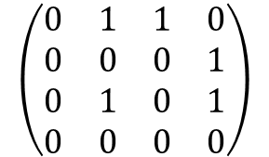
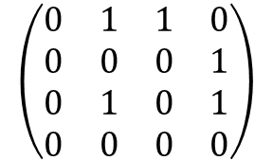
2-Hop Neighbors (through Matrix Multiplication)
Matrix multiplication for finding two-hop neighbors
Node 3 is a two-hop neighbor of node 0 along two different paths
 | 0 | 1 | 2 | 3
0 | 0 | 1 | 1 | 0
1 | 0 | 0 | 0 | 1
2 | 0 | 1 | 0 | 1
3 | 0 | 0 | 0 | 0
 | 0 | 1 | 2 | 3
0 | 0 | 1 | 0 | 2
1 | 0 | 0 | 0 | 0
2 | 0 | 0 | 0 | 1
3 | 0 | 0 | 0 | 0
0
1
Node 3 is a two-hop neighbor of node 2 along 1 path
2
3
A graph and its adjacency matrix representation
The adjacency matrix representation
The adjacency matrix representation for two-hop neighbors, obtained by matrix-matrix product of the adjacency matrix
2
$$\left(\begin{matrix}0 & 1 & 1 & 0 \\ 0 & 0 & 0 & 1 \\ 0 & 1 & 0 & 1 \\ 0 & 0 & 0 & 0\end{matrix}\right)$$
$$\left(\begin{matrix}0 & 1 & 1 & 0 \\ 0 & 0 & 0 & 1 \\ 0 & 1 & 0 & 1 \\ 0 & 0 & 0 & 0\end{matrix}\right)$$
$$\left(\begin{matrix}0 & 1 & 1 & 0 \\ 0 & 0 & 0 & 1 \\ 0 & 1 & 0 & 1 \\ 0 & 0 & 0 & 0\end{matrix}\right)$$
$$\left(\begin{matrix}0 & 1 & 0 & 2 \\ 0 & 0 & 0 & 0 \\ 0 & 0 & 0 & 1 \\ 0 & 0 & 0 & 0\end{matrix}\right)$$
=
=
Notes:
Matrix multiplication is well studied and optimized in software and hardware, and can be done very fast
For all the vertices in the graph
Consider the multiplication of the first row of the left matrix wit the last column of the right matrix:
0*0 + 1*1 + 1*1 + 0*0 = 2.
This means that there are two 2-hop paths from 1 to 3:
Path 0→1→ 3 consisting of two edges 0→1 & 1→ 3, corresponding to the first term of 1*1
Path 0→2→ 3 consisting of two edges 0→2 &2→ 3, corresponding to the second term of 1*1

Slide 14
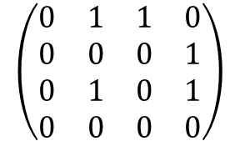
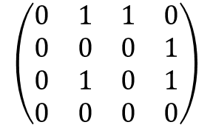
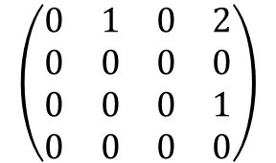
2-Hop Neighbors (through Matrix Multiplication)
Consider the multiplication of the first row of the left matrix wit the last column of the right matrix:
0*0 + 1*1 + 1*1 + 0*0 = 2.
This means that there are two 2-hop paths from 1 to 3:
Path 0→1→ 3 consisting of two edges 0→1 & 1→ 3, corresponding to the first term of 1*1
Path 0→2→ 3 consisting of two edges 0→2 &2→ 3, corresponding to the second term of 1*1
Path 0→1→ 3
$$\left(\begin{matrix}0 & 1 & 1 & 0 \\ 0 & 0 & 0 & 1 \\ 0 & 1 & 0 & 1 \\ 0 & 0 & 0 & 0\end{matrix}\right)$$
$$\left(\begin{matrix}0 & 1 & 1 & 0 \\ 0 & 0 & 0 & 1 \\ 0 & 1 & 0 & 1 \\ 0 & 0 & 0 & 0\end{matrix}\right)$$
$$\left(\begin{matrix}0 & 1 & 0 & 2 \\ 0 & 0 & 0 & 0 \\ 0 & 0 & 0 & 1 \\ 0 & 0 & 0 & 0\end{matrix}\right)$$
0
1
=
2
3
Path 0→2→ 3

Slide 15
Graph Traversals
Topological Sort
Shortest Path

Slide 16
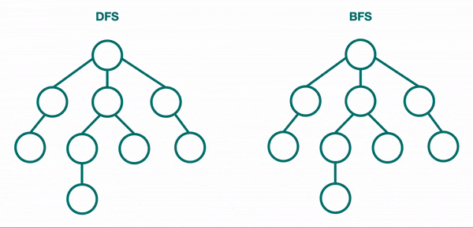
BFS & DFS for Trees

Slide 17
Breadth-First Search (BFS)
BFS: Explore nodes “layer by layer”; like level-order traversal of a tree, now generalized to any graph; visit 1-hop neighbors, then 2-hop neighbors, …, until all nodes have been visited
2
3
VISITED
4
This is our goal, but how do we translate into code?
Use a data structure to ”queue up” children…
s
1
9
7
0
2
4
1
5
for (Vertex n : s.neighbors) {
6
3
8
Notes:
Key observation: recursive calls interrupted s.neighbors loop to immediately process children
For BFS, instead we want to complete that loop before processing children
closer nodes first, instead of following one choice all the way to the end

Slide 18
BFS Implementation
A queue keeps track of “outer edge” of nodes still to explore
bfs(Graph graph, Vertex start) {
Queue<Vertex> perimeter = new Queue<>();
Set<Vertex> visited = new Set<>();
perimeter.add(start);
visited.add(start);
Kick off the algorithm by adding start to perimeter
while (!perimeter.isEmpty()) {
Vertex from = perimeter.remove();
3
Grab one element at a time from the perimeter
for (Edge edge : graph.edgesFrom(from)) {
Vertex to = edge.to();
4
Look at all that element’s children
if (!visited.contains(to)) {
perimeter.add(to);
visited.add(to);
}
}
}
}
start
1
9
7
Add new ones to perimeter!
2
5
6
8

Slide 19
BFS Implementation: In Action
PERIMETER
bfs(Graph graph, Vertex start) {
Queue<Vertex> perimeter = new Queue<>();
Set<Vertex> visited = new Set<>();
perimeter.add(start);
visited.add(start);
while (!perimeter.isEmpty()) {
Vertex from = perimeter.remove();
for (Edge edge : graph.edgesFrom(from)) {
Vertex to = edge.to();
if (!visited.contains(to)) {
perimeter.add(to);
visited.add(to);
}
}
}
}
1
2
4
5
3
6
8
9
7
3
VISITED
start
4
1
9
7
2
5
6
8

Slide 20
BFS Intuition: Why Does it Work?
Using FIFO queue means we explore an entire layer before moving on to the next layer
Keep going until perimeter is empty
PERIMETER
bfs(Graph graph, Vertex start) {
Queue<Vertex> perimeter = new Queue<>();
Set<Vertex> visited = new Set<>();
perimeter.add(start);
visited.add(start);
while (!perimeter.isEmpty()) {
Vertex from = perimeter.remove();
for (Edge edge : graph.edgesFrom(from)) {
Vertex to = edge.to();
if (!visited.contains(to)) {
perimeter.add(to);
visited.add(to);
}
}
}
}
1
2
4
5
3
6
8
9
7
2
3
VISITED
start
4
1
9
0
7
2
4
1
5
6
3
8

Slide 21
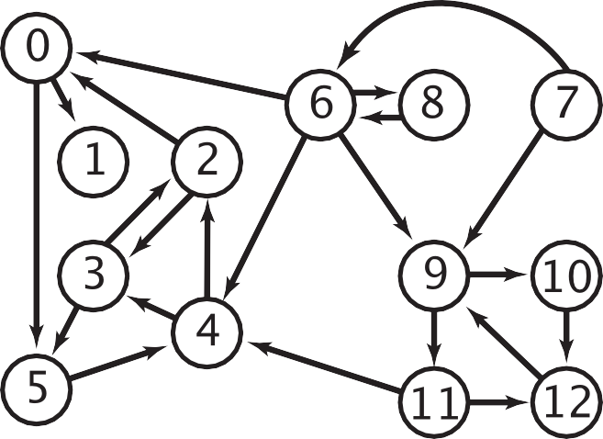



BFS Application: Multiple-Source Shortest Paths Problem
Given a digraph and a set of source vertices, find shortest path from any vertex in the set to every other vertex, assuming all edges have weight 1.
e.g., S = { 1, 7, 10 }.
Shortest path to 4 is 7 → 6 → 4.
Shortest path to 5 is 7 → 6 → 0 → 5.
Shortest path to 12 is 10 → 12.
Can be done with BFS, and initialize by enqueuing all source nodes
0
1
6
5
8
7
9
2
4
10
12
3
11
dist = 0
dist = 1
dist = 2
dist = 3

Slide 22
Depth-First Search (DFS) (Recursive Algorithm)
DFS explores one branch “all the way down” before coming back to try branches
Depending on the order of visiting branches, many possible orderings: e.g., {1, 2, 5, 6, 9, 7, 8, 4, 3}, {1, 4, 3, 2, 5, 8, 6, 7, 9}, etc.
Set<Vertex> visited; // assume global
connected(Vertex s, Vertex t) {
if (s == t) {
return true;
} else {
visited.add(s);
for (Vertex n : s.neighbors) {
if (!visited.contains(n)) {
if (connected(n, t)) {
return true;
}
}
}
return false;
}
}
VISITED
3
s
1
4
7
9
2
5
6
8
Notes:
What order does this algorithm use to visit nodes?
Assume order of s.neighbors is arbitrary!

Slide 23
DFS w/ Stack vs. BFS w/ Queue
dfs(Graph graph, Vertex start) {
Stack<Vertex> perimeter = new Stack<>();
Set<Vertex> visited = new Set<>();
perimeter.add(start);
while (!perimeter.isEmpty()) {
Vertex from = perimeter.remove();
if (!visted.contains(from)) {
for (Edge edge:graph.edgesFrom(from)) {
Vertex to = edge.to();
perimeter.add(to)
}
visited.add(from);
}
}
}
bfs(Graph graph, Vertex start) {
Queue<Vertex> perimeter = new Queue<>();
Set<Vertex> visited = new Set<>();
perimeter.add(start);
visited.add(start);
while (!perimeter.isEmpty()) {
Vertex from = perimeter.remove();
for (Edge edge : graph.edgesFrom(from)) {
Vertex to = edge.to();
if (!visited.contains(to)) {
perimeter.add(to);
visited.add(to);
}
}
}
}
Notes:
In DFS we can’t immediately add a node as “visited”. We need to make sure we are only marking the node when it is popped.

Slide 24
Recap: Graph Traversals
DFS
(Iterative)
Follow a “choice” all the way to the end, then come back to revisit other choices
Uses a stack!
BFS
(Iterative)
Explore layer-by-layer: examine every node at a certain distance from start, then examine nodes that are one level farther
Uses a queue!
DFS
(Recursive)
On huge graphs, might overflow the call stack

Slide 25
Topological Sort
Given a DAG
A Directed Acyclic Graph (DAG) : A directed graph (digraph) without any cycles
A DAG encodes a “dependency graph”
An edge (u, v) means u must precede v
A topological sort or topological ordering of a DAG gives a total node ordering that respects dependencies
Applications:
Compiling multiple Java files
Multi-job Workflows
A before C
A
A before B
C
B
B before C
Topological Sort:
A
B
C
C before A
A
With original edges for reference:
A before B
C
B
A
B
C
B before C
Not a DAG. No possible topological sort
Notes:
A directed graph without any cycles
Edges may or may not be weighted
Given: a DAG, find: a total ordering of the vertices so all edges go from left to right (all the dependency arrows are satisfied and the vertices can be processed left to right with no problems) .
A topological sort of a directed acyclic graph (DAG) G is an ordering of the nodes, where for every edge in the graph, the origin appears before the destination in the ordering
If a vertex doesn’t have any edges going into it, we can add it to the ordering.
In general, topological sorts are not unique

Slide 26
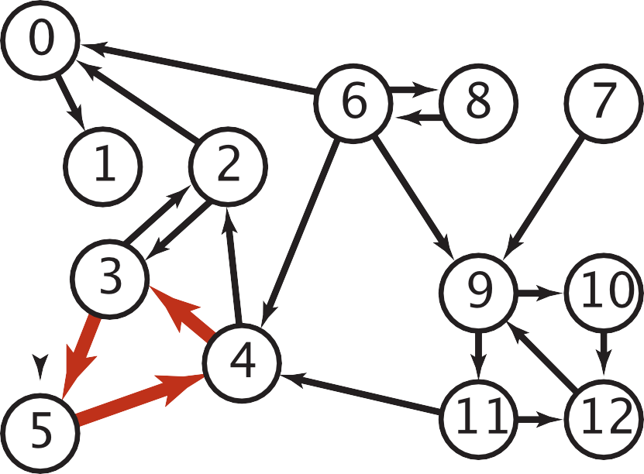

Cycles and Undirected Edges
Why is topological sort not possible for digraphs containing cycles?
Imagine a graph with 3 vertices and edges = {1 to 2 , 2 to 3, 3 to 1} forming a cycle. Now if we try to topologically sort this graph starting from any vertex, it will always create a contradiction to our definition. All the vertices in a cycle are indirectly dependent on each other hence topological sortfails
Why is topological sort not possible for graphs with undirected edges?
Special case of a cycle. Undirected edge between two vertices u and v means, there is an edge from u to v as well as from v to u. Because of this both the nodes u and v depend upon each other and none of them can appear before the other in the topological sortwithout creating a contradiction
a digraph with a directed cycle

Slide 27
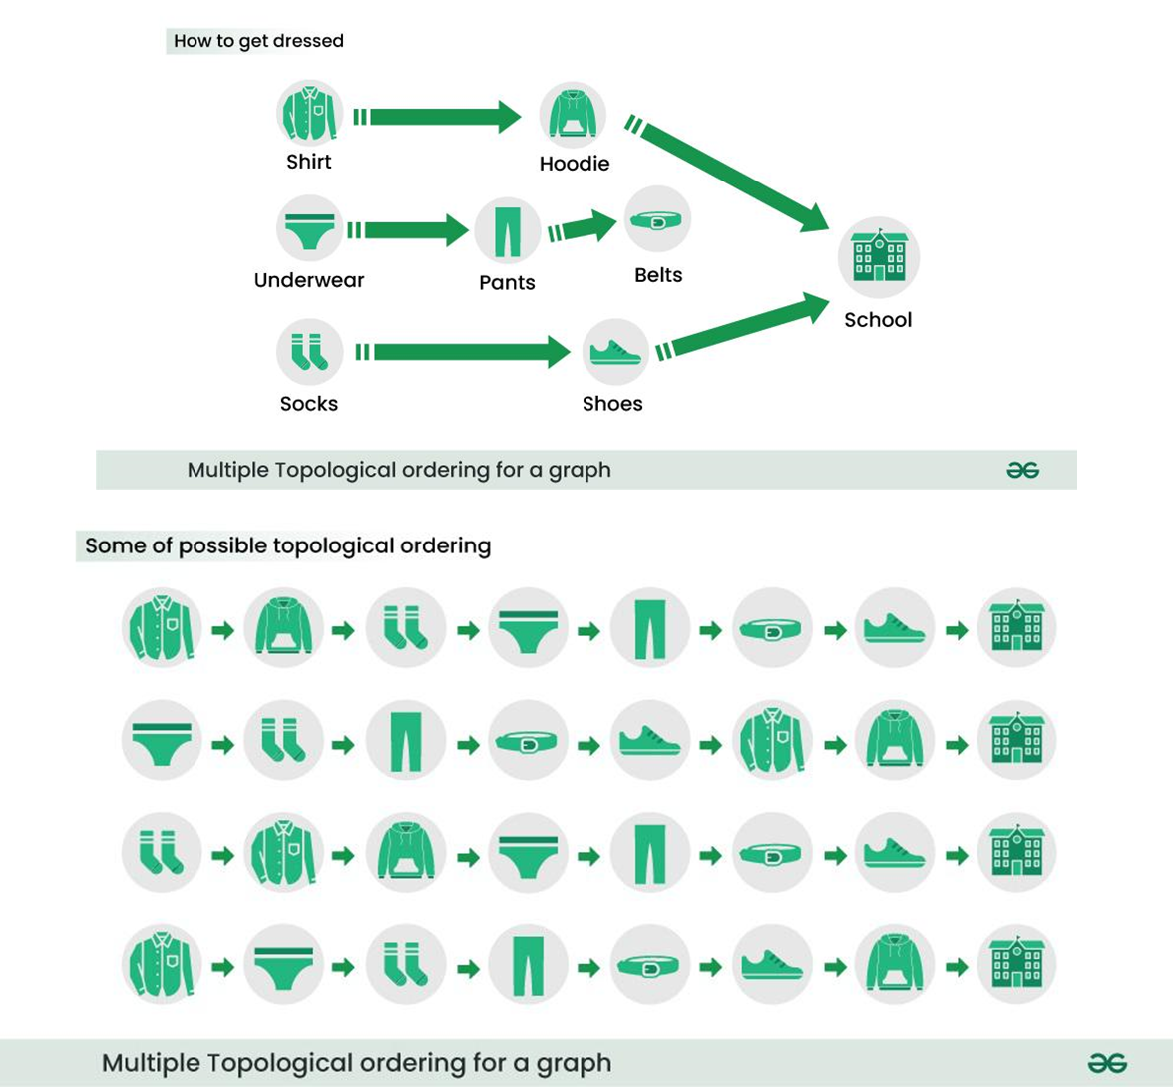
Topological Sort Example I

Slide 28
Topological Sort Example II
Give all possible topological orderings of this DAG
A
C
D
B
E
By observation, we can get (A, C, B, D, E), (A, C, B, E, D)
Notes:
More generally, if the only incoming edges are from vertices already in the ordering, it’s safe to add.

Slide 29
Topological Sort Example III
Give all possible topological orderings of this DAG
A
C
D
B
E
E
By observation, we can get: all possible interleavings with (AB) or (BA) before C, (DEF) or (DFE) or (EFD) after C. e.g., ABCDEF, BACEDF, etc.

Slide 30
Topological Sort by DFS Post-Order Traversal
Perform DFS Post-Order Traversal starting from any node (often, but not necessarily, a node with no incoming edges (no predecessors)) to get an ordered list of nodes, then reverse the node order to get a Topological Sort
Upon finishing traversal starting from one node, restart from another unvisited node with no incoming edges
This results in one of multiple possible Topological Sorts
Intuition: DFS Post-Order Traversal outputs nodes from the deepest (furthest away from the starting node) to the starting mode, hence the reverse order is a Topological Sort from the starting node

Slide 31
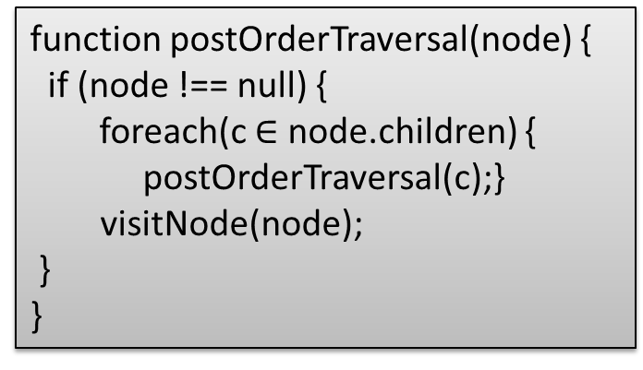
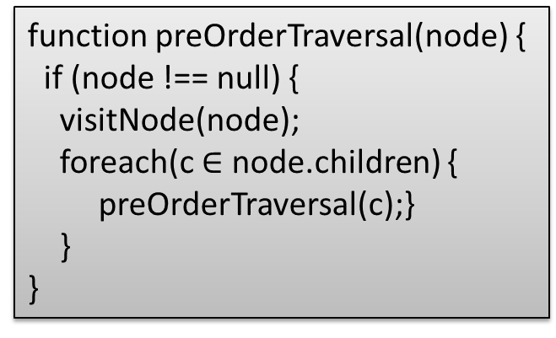
DFS Traversal: Pre-order, Post-order
function preOrderTraversal(node) {
if (node !== null) {
visitNode(node);
preOrderTraversal(node.left);
preOrderTraversal(node.right);
}
}
function postOrderTraversal(node) {
if (node !== null) {
postOrderTraversal(node.left);
postOrderTraversal(node.right);
visitNode(node);
}
}
Recall: Binary Tree traversal with DFS: pre-order, post-order
function preOrderTraversal(node) {
if (node !== null) {
visitNode(node);
foreach(c $∈$ node.children) {
preOrderTraversal(c);}
}
}
function postOrderTraversal(node) {
if (node !== null) {
foreach(c $∈$ node.children) {
postOrderTraversal(c);}
visitNode(node);
}
}
Graph traversal with DFS: pre-order, post-order (for post-order, visit a node during backtrack when all its children have been visited)

Slide 32
DFS Traversal Example I
Start from node 0
Visit nodes 0->1->4. Since 4 has no successors, backtrack to 0.
Pre-order: (0, 1, 4); post-order: (4, 1)
Visit node 2. Since 2 has no successors, backtrack to 0
Pre-order: (0, 1, 4, 2); post-order: (4, 1, 2)
Visit node 5. Since 5’s successor 2 has been visited, backtrack to 0. Since all of node 0’s successors have been visited, we visit it in post-order
Pre-order: (0, 1, 4, 2, 5); post-order: (4, 1, 2, 5, 0)
Restart from node 3, visit its successor 6, then backtrack. Since all of node 3’s successors have been visited, we visit it in post-order
Pre-order: (0, 1, 4, 2, 5, 3, 6); post-order: (4, 1, 2, 5, 0, 6, 3)
All nodes and their successors have been visited, so the algorithm terminates. A topological sort corresponding to this post-order is (3, 6, 0, 5, 2, 1, 4)
This is one of many possible traversals, e.g., if we start from another node 3 with no predecessors, then we have the traversals: pre-order: (3, 5, 2, 4, 6, 0, 1); post-order: (2, 5, 4, 3, 1, 0, 6); Topological sort: (6, 0, 1, 3, 4, 5, 2); BFS traversal: (3, 2, 5, 4, 6, 0, 1)
A BFS traversal: (0, 2, 5, 1, 4, 3, 6)
0
0
2
5
1
3
4
6

Slide 33
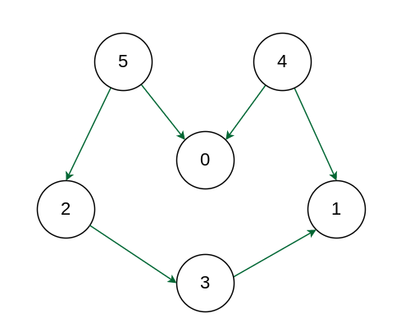
DFS Traversal Example II
Starting from node 5:
Pre-order traversal: (5, 2, 3, 1, 0, 4)
Post-order traversal: (1, 3, 2, 0, 5, 4)
Topological sort: (4, 5, 0, 2, 3, 1)
BFS traversal: (5, 0, 2, 3, 1, 4)
Starting from node 4:
Pre-order traversal: (4, 0, 1, 5, 2, 3)
Post-order traversal: (0, 1, 4, 3, 2, 5)
Topological sort: (5, 2, 3, 4, 1, 0)
BFS traversal: (4, 0, 1, 5, 2, 3)
Starting from node 0:
Pre-order traversal: (0, 5, 2, 3, 1, 4)
Post-order traversal: (0, 1, 3, 2, 5, 4)
Topological sort: (4, 5, 2, 3, 1, 0)
BFS traversal: (0, 5, 2, 3, 1, 4)
You may try starting any other node.

Slide 34
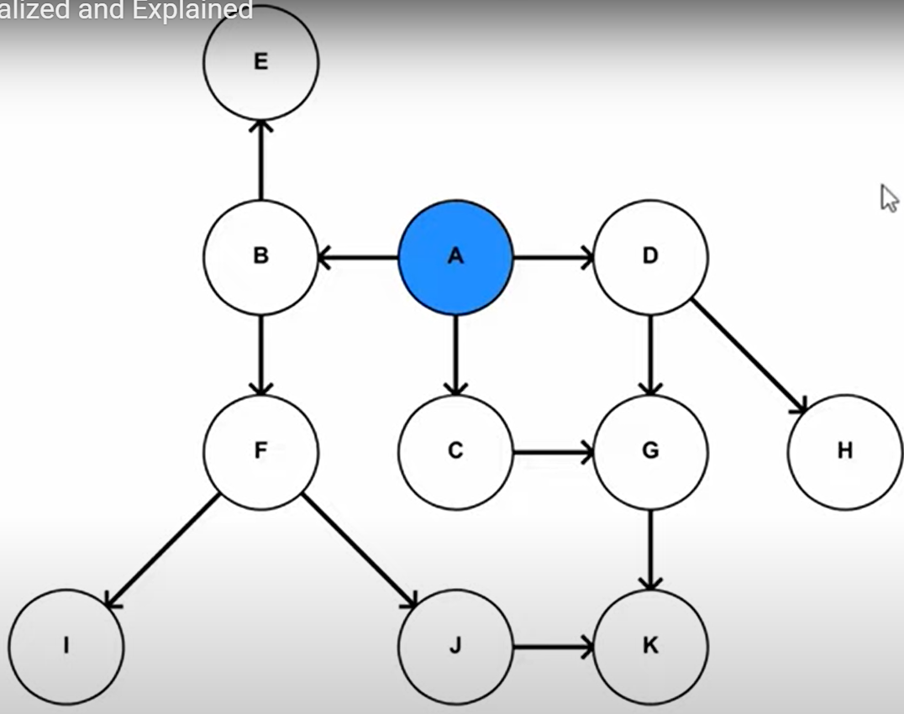
DFS Traversal Example III
Starting from node A:
Pre-order traversal: (A, B, F, I, J, K, E, C, G, D, H)
Post-order traversal: (I, K, J, F, E, B, G, C, H, D, A)
Topological sort: (A, D, H, C, G, B, E, F, J, K, I)
BFS traversal: (A, B, C, D, E, F, G, H, I, J, K)
Starting from a different node will give a different topological sort, but all of them must start with A, since it is the only node without any predecessors (i.e., it must precede all the other nodes based on the DAG)
Any post-order traversal must visit A last, since all of A’s sucessors must be visited before visiting A
Topological Sort Visualized and Explained
https://www.youtube.com/watch?v=7J3GadLzydI
Notes:
A topological sort is reverse order of Post-order traversal: “A D H C G B E F J K I”.

Slide 35
Kahn’s algorithm for Topological Sort
The algorithm works by repeatedly finding vertices with no incoming edges, removing them from the graph, and updating the incoming edges of the remaining vertices. This process continues until all vertices have been ordered.
Add all nodes with in-degree 0 to a queue.
While the queue is not empty:
Remove a node from the queue.
For each outgoing edge from the removed node, decrement the in-degree of the destination node by 1.
If the in-degree of a destination node becomes 0, add it to the queue.
If the queue is empty and there are still nodes in the graph, the graph contains a cycle and cannot be topologically sorted.
The nodes in the queue represent the topological sort of the graph.
Time Complexity: O(V+E).
The outer for loop will be executed V number of times and the inner for loop will be executed E number of times.
https://www.geeksforgeeks.org/topological-sorting-indegree-based-solution/

Slide 36
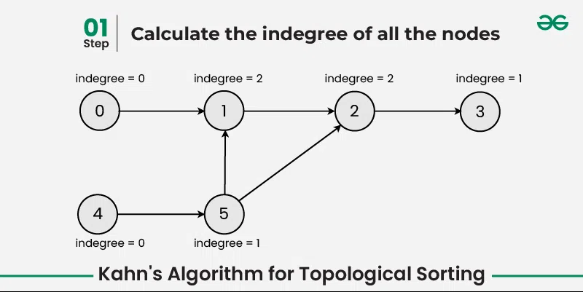
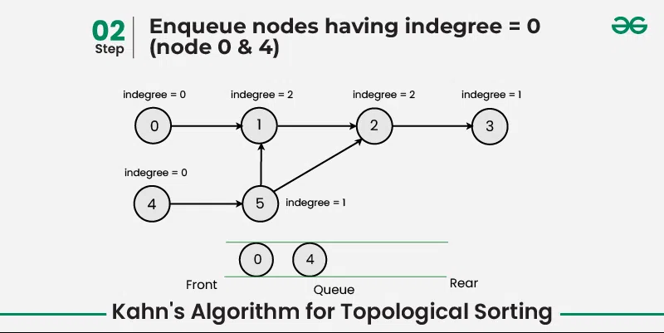
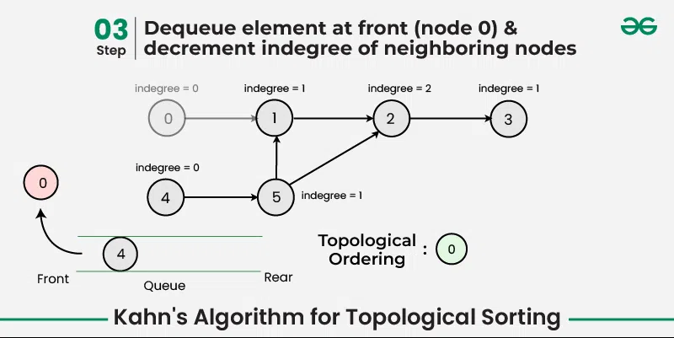
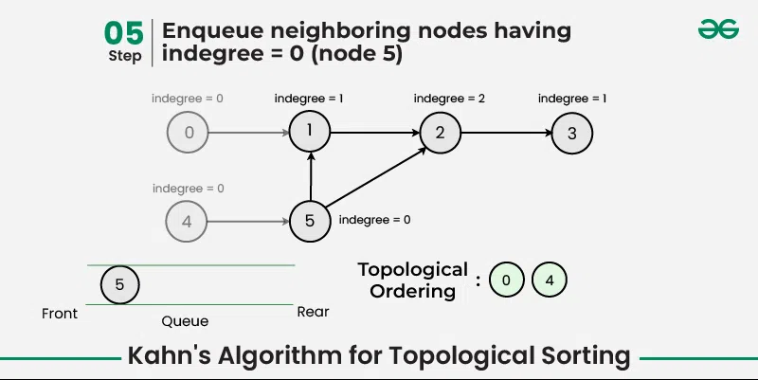
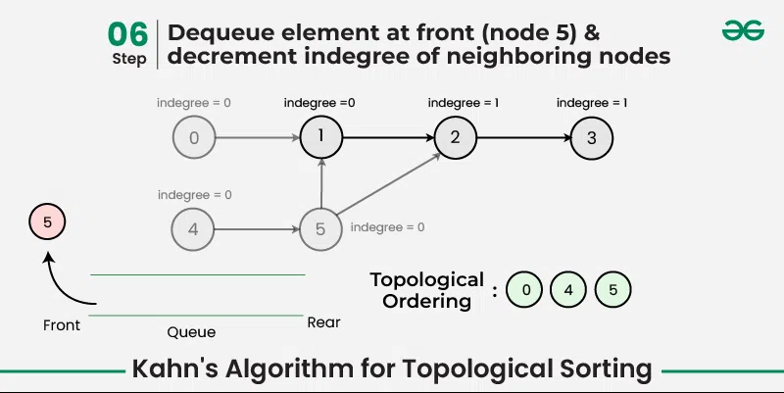
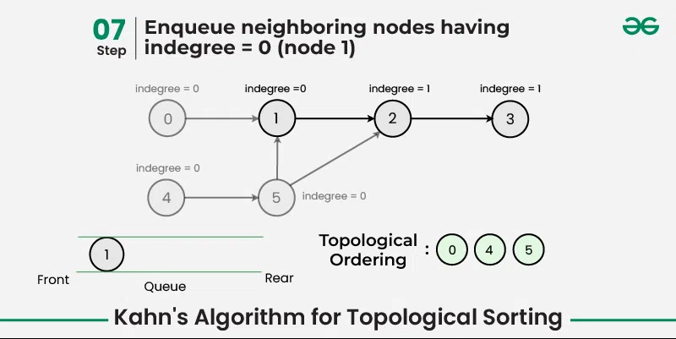

Slide 37
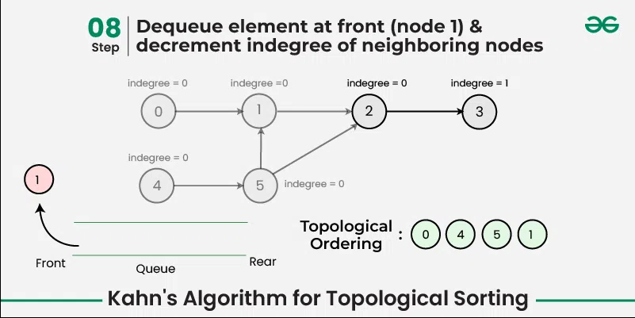
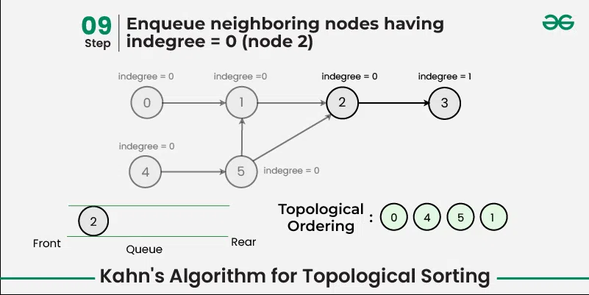
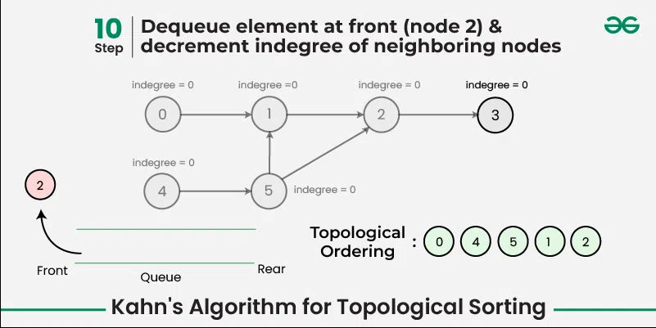
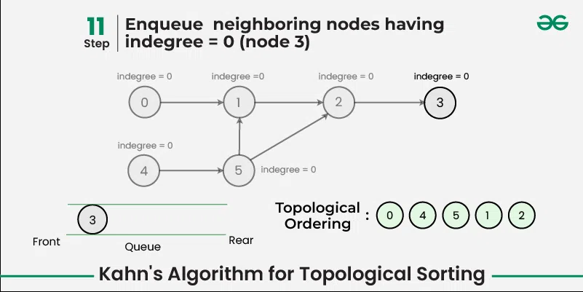
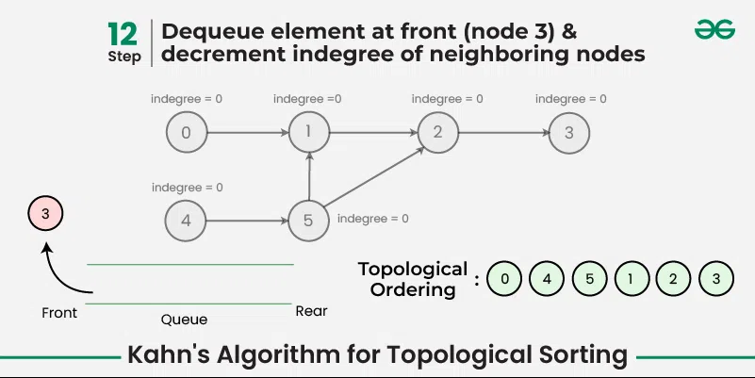
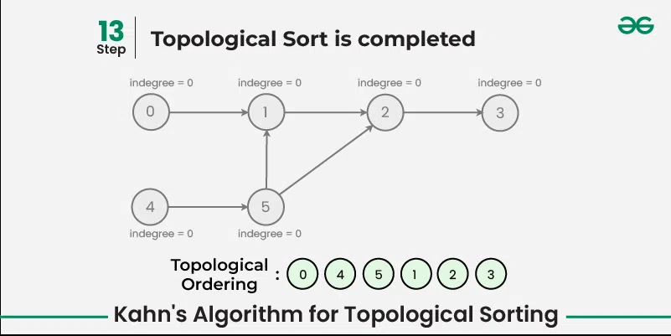

Slide 38
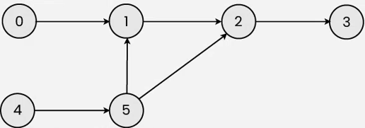
Graph Traversals
Give one DFS pre-order, in-order and post-order traversal of the following graph, and a topological sort.
Starting from node 4:
Pre-order traversal: (4, 5, 1, 2, 3, 0)
Post-order traversal: (3, 2, 1, 5, 4, 0)
Topological Sort: (0, 4, 5, 1, 2, 3)
BFS: (4, 5, 1, 2, 3, 0)
Starting from node 0:
Pre-order traversal: (0, 1, 2, 3, 4, 5)
Post-order traversal: (3, 2, 1, 0, 5, 4)
Topological Sort: (4, 5, 0, 1, 2, 3)
BFS: (0, 1, 2, 3, 4, 5)

Slide 39
References
Breadth-first search in 4 minutes (for a tree)
https://www.youtube.com/watch?v=HZ5YTanv5QE
Depth-first search in 4 minutes (for a tree)
https://www.youtube.com/watch?v=Urx87-NMm6c
Graph Traversals - Breadth First and Depth First (for an undirected graph)
https://www.youtube.com/watch?v=bIA8HEEUxZI
Notes:
Depth First Search Algorithm
https://www.youtube.com/watch?v=iaBEKo5sM7w
Breadth First Search Algorithm
https://www.youtube.com/watch?v=QRq6p9s8NVg

Slide 40
Graph Traversals
Topological Sort
Shortest Path

Slide 41
The Shortest Path Problem
(Unweighted) Shortest Path Problem
Given source vertex s and a target vertex t, how long is the shortest path from s to t? What edges makeup that path?
This is a little harder, but still totally doable! We just need a way to keep track of how far each node is from the start.
Sounds like a job for?

Slide 42
Using BFS for the Shortest Path Problem
...
Map<Vertex, Edge> edgeTo = ...
Map<Vertex, Double> distTo = ...
edgeTo.put(start, null);
distTo.put(start, 0.0);
while (!perimeter.isEmpty()) {
Vertex from = perimeter.remove();
for (Edge edge : graph.edgesFrom(from)) {
Vertex to = edge.to();
if (!visited.contains(to)) {
edgeTo.put(to, edge);
distTo.put(to, distTo.get(from) + 1);
perimeter.add(to);
visited.add(to);
}
}
}
return edgeTo;
}
(Unweighted) Shortest Path Problem
(Unweighted) Shortest Path Problem
The start required no edge to arrive at, and is on level 0
Given source vertex s and a target vertex t, how long is the shortest path from s to t? What edges make up that path?
Given source vertex s and a target vertex t, how long is the shortest path from s to t? What edges makeup that path?
We need to keep track of how far each node is from the start, using BFS
Remember how we got to this point, and what layer this vertex is part of

Slide 43
BFS for Shortest Paths: Example
...
Map<Vertex, Edge> edgeTo = ...
Map<Vertex, Double> distTo = ...
edgeTo.put(start, null);
distTo.put(start, 0.0);
while (!perimeter.isEmpty()) {
Vertex from = perimeter.remove();
for (Edge edge : graph.edgesFrom(from)) {
Vertex to = edge.to();
if (!visited.contains(to)) {
edgeTo.put(to, edge);
distTo.put(to, distTo.get(from) + 1);
perimeter.add(to);
visited.add(to);
}
}
}
return edgeTo;
}
PERIMETER
A
B
C
D
E
DISTTO
2
E
VISITED
0
start
A
1
C
EDGETO
1
B
2
D
The edgeTo map stores backpointers: each vertex remembers what vertex was used to arrive at it!
Note: this code stores visited, edgeTo, and distTo as external maps (only drawn on graph for convenience). Another implementation option: store them as fields of the nodes themselves

Slide 44
What about the Target Vertex?
This modification on BFS didn’t mention the target vertex at all!
Instead, it calculated the shortest path and distance from start to every other vertex
This is called the shortest path tree
A general concept: in this implementation, made up of distances and backpointers
Shortest path tree has all the answers!
Length of shortest path from A to D?
Lookup in distTo map: 2
What’s the shortest path from A to D?
Build up backwards from edgeTo map: start at D, follow backpointer to B, follow backpointer to A – our shortest path is A 🡪 B 🡪 D
All our shortest path algorithms will have this property
If you only care about t, you can sometimes stop early!
Shortest Path Tree:
DISTTO
2
E
0
start
A
1
C
EDGETO
1
B
2
D

Slide 45
Recap: Graph Problems
Just like everything is Graphs, every problem is a Graph Problem
BFS and DFS are very useful tools to solve these! We’ll see plenty more.
start
A
14.0
C
target
12.0
1.5
B
D
9000.2
s-t Connectivity Problem
(Unweighted) Shortest Path Problem
What about the Shortest Path Problem on a weighted graph?
Suppose we want to find shortest path from A to C, using weight of each edge as “distance”
Given source vertex s and a target vertex t, does there exist a path between s and t?
Given source vertex s and a target vertex t, how long is the shortest path from s to t? What edges make up that path?
BFS or DFS + check if we’ve hit t
BFS + generate shortest path tree as we go

Slide 46
Dijkstra’s Algorithm
Named after its inventor, Edsger Dijkstra (1930-2002)
Truly one of the “founders” of computer science
1972 Turing Award
The idea: reminiscent of BFS, but adapted to handle weights
Grow the set of nodes whose shortest distance has been computed
Nodes not in the set will have a “best distance so far”

Slide 47
Dijkstra’s Algorithm: Idea
PERIMETER
2
4??
UNKNOWN
0
2
2
3
∞
start
A
B
F
H
1
4
5
10
2
∞
1
9
1
3
G
4
2
C
KNOWN
D
11
1
E
7
12??
Initialization:
Start vertex has distance 0; all other vertices have distance ∞
At each step:
Pick closest unknown vertex v
Add it to the “cloud” of known vertices
Update “best-so-far” distances for vertices with edges from v

Slide 48
Dijkstra’s Pseudocode (High-Level)
0
KNOWN
start
A
2
2
PERIMETER
B
5
Suppose we already visited B, distTo[D] = 7
Now considering edge (C, D):
oldDist = 7
newDist = 3 + 1
That’s better! Update distTo[D], edgeTo[D]
3
3
7??
Similar to “visited” in BFS, “known” is nodes that are finalized (we know their path)
C
u
1
v
D
dijkstraShortestPath(G graph, V start)
Dijkstra’s algorithm is all about updating “best-so-far” in distTo if we find shorter path! Init all paths to infinite.
Set known; Map edgeTo, distTo;
initialize distTo with all nodes mapped to ∞, except start to 0
while (there are unknown vertices):
let u be the closest unknown vertex
known.add(u);
Order matters: always visit closest first!
for each edge (u,v) from u with weight w:
oldDist = distTo.get(v) // previous best path to v
newDist = distTo.get(u) + w // what if we went through u?
Consider all vertices reachable from me: would getting there through me be a shorter path than they currently know about?
if (newDist < oldDist):
distTo.put(v, newDist)
edgeTo.put(v, u)

Slide 49
Dijkstra’s Algorithm: Key Properties
Once a vertex is marked known, its shortest path is known
Can reconstruct path by following back-pointers (in edgeTo map)
dijkstraShortestPath(G graph, V start)
Set known; Map edgeTo, distTo;
initialize distTo with all nodes mapped to ∞, except start to 0
while (there are unknown vertices):
let u be the closest unknown vertex
known.add(u)
for each edge (u,v) to unknown v with weight w:
oldDist = distTo.get(v) // previous best path to v
newDist = distTo.get(u) + w // what if we went through u?
if (newDist < oldDist):
distTo.put(v, newDist)
edgeTo.put(v, u)
While a vertex is not known, another shorter path might be found
We call this update relaxing the distance because it only ever shortens the current best path
Going through closest vertices first lets us confidently say no shorter path will be found once known
Because not possible to find a shorter path that uses a farther vertex we’ll consider later

Slide 50
Dijkstra’s Algorithm: Runtime
Important for P4!
dijkstraShortestPath(G graph, V start)
Set known; Map edgeTo, distTo;
initialize distTo with all nodes mapped to ∞, except start to 0
while (there are unknown vertices):
let u be the closest unknown vertex
known.add(u)
for each edge (u,v) to unknown v with weight w:
oldDist = distTo.get(v) // previous best path to v
newDist = distTo.get(u) + w // what if we went through u?
if (newDist < oldDist):
distTo.put(v, newDist)
edgeTo.put(v, u)
O(|V|)
come back…
How do we find this??
O(1) for HashSet
O(|E|) worst case
O(1) for HashMap
We can use an optimized structure that will tell us the “minimum” distance vertex, and let us “update distance” as we go…
Use a HeapMinPriorityQueue! (like the one from P3)

Slide 51
Dijkstra’s Algorithm: Runtime
dijkstraShortestPath(G graph, V start)
Set known; Map edgeTo, distTo;
initialize distTo with all nodes mapped to ∞, except start to 0
while (there are unknown vertices):
let u be the closest unknown vertex
known.add(u)
for each edge (u,v) to unknown v with weight w:
oldDist = distTo.get(v) // previous best path to v
newDist = distTo.get(u) + w // what if we went through u?
if (newDist < oldDist):
distTo.put(v, newDist)
edgeTo.put(v, u)
update distance in list of unknown vertices
O(|V|)
O(|V|)
O(log|V|)
O(|E|)
O(log|V|)
Final runtime: O(|V|log|V| + |E|log|V|)

Slide 52
Dijkstra’s Algorithm: Example #1
0
2
∞
∞
∞
start
B
2
3
A
F
H
1
4
5
10
2
∞
1
9
∞
3
G
∞
2
C
11
∞
D
1
E
Vertex | Known? | distTo | edgeTo
A |  | ∞
B |  | ∞
C |  | ∞
D |  | ∞
E |  | ∞
F |  | ∞
G |  | ∞
H |  | ∞
7
Order Added to Known Set:

Slide 53
Dijkstra’s Algorithm: Example #1
0
2
2??
∞
∞
start
B
2
3
A
F
H
1
4
5
10
2
∞
1
9
1??
3
G
4??
2
C
11
∞
D
1
E
Vertex | Known? | distTo | edgeTo
A | Y | 0 | /
B |  | ≤ 2 | A
C |  | ≤ 1 | A
D |  | ≤ 4 | A
E |  | ∞
F |  | ∞
G |  | ∞
H |  | ∞
7
Order Added to Known Set:
A

Slide 54
Dijkstra’s Algorithm: Example #1
0
2
2??
∞
∞
start
B
2
3
A
F
H
1
4
5
10
2
∞
1
9
1
3
G
4??
2
C
11
12??
D
1
E
Vertex | Known? | distTo | edgeTo
A | Y | 0 | /
B |  | ≤ 2 | A
C | Y | 1 | A
D |  | ≤ 4 | A
E |  | ≤ 12 | C
F |  | ∞
G |  | ∞
H |  | ∞
7
Order Added to Known Set:
A, C
Notes:
Note how E’s distance is 12 (path length) instead of 11 (edge weight)

Slide 55
Dijkstra’s Algorithm: Example #1
0
2
2
4??
∞
start
B
2
3
A
F
H
1
4
5
10
2
∞
1
9
1
3
G
4??
2
C
11
12??
D
1
E
Vertex | Known? | distTo | edgeTo
A | Y | 0 | /
B | Y | 2 | A
C | Y | 1 | A
D |  | ≤ 4 | A
E |  | ≤ 12 | C
F |  | ≤ 4 | B
G |  | ∞
H |  | ∞
7
Order Added to Known Set:
A, C, B
Notes:
Note how
Again, we don’t set F’s pathlen to 2 (the edge weight); we set it to 4 (length of A->B->F)
We don’t update C with distance 7 (A->B->C); its optimal path is already known
We don’t update E with distance 12 (A->B->E); the path length is the same

Slide 56
Dijkstra’s Algorithm: Example #1
0
2
2
4??
∞
start
B
2
3
A
F
H
1
4
5
10
2
∞
1
9
1
3
G
4
2
C
11
12??
D
1
E
Vertex | Known? | distTo | edgeTo
A | Y | 0 | /
B | Y | 2 | A
C | Y | 1 | A
D | Y | 4 | A
E |  | ≤ 12 | C
F |  | ≤ 4 | B
G |  | ∞
H |  | ∞
7
Order Added to Known Set:
A, C, B, D
Notes:
Nothing was updated; we already had an optimal path to C

Slide 57
Dijkstra’s Algorithm: Example #1
0
2
2
4
7??
start
B
2
3
A
F
H
1
4
5
10
2
∞
1
9
1
3
G
4
2
C
11
12??
D
1
E
Vertex | Known? | distTo | edgeTo
A | Y | 0 | /
B | Y | 2 | A
C | Y | 1 | A
D | Y | 4 | A
E |  | ≤ 12 | C
F | Y | 4 | B
G |  | ∞
H |  | ≤ 7 | F
7
Order Added to Known Set:
A, C, B, D, F

Slide 58
Dijkstra’s Algorithm: Example #1
0
2
2
4
7
start
B
2
3
A
F
H
1
4
5
10
2
8??
1
9
1
3
G
4
2
C
11
12??
D
1
E
Vertex | Known? | distTo | edgeTo
A | Y | 0 | /
B | Y | 2 | A
C | Y | 1 | A
D | Y | 4 | A
E |  | ≤ 12 | C
F | Y | 4 | B
G |  | ≤ 8 | H
H | Y | 7 | F
7
Order Added to Known Set:
A, C, B, D, F, H

Slide 59
Dijkstra’s Algorithm: Example #1
0
2
2
4
7
start
B
2
3
A
F
H
1
4
5
10
2
8
1
9
1
3
G
4
2
C
11
11??
D
1
E
Vertex | Known? | distTo | edgeTo
A | Y | 0 | /
B | Y | 2 | A
C | Y | 1 | A
D | Y | 4 | A
E |  | ≤ 11 | G
F | Y | 4 | B
G | Y | 8 | H
H | Y | 7 | F
7
Order Added to Known Set:
A, C, B, D, F, H, G
Notes:
Note how we found a better path to E at last (A->B->F->H->G->E), with cost 11; formerly path A->C->E had cost 12

Slide 60
Dijkstra’s Algorithm: Example #1
0
2
2
4
7
start
B
2
3
A
F
H
1
4
5
10
2
8
1
9
1
3
G
4
2
C
11
11
D
1
E
Vertex | Known? | distTo | edgeTo
A | Y | 0 | /
B | Y | 2 | A
C | Y | 1 | A
D | Y | 4 | A
E | Y | 11 | G
F | Y | 4 | B
G | Y | 8 | H
H | Y | 7 | F
7
Order Added to Known Set:
A, C, B, D, F, H, G, E
Notes:
Done!

Slide 61
Dijkstra’s Algorithm: Interpreting the Results
0
2
2
4
7
Now that we’re done, how do we get the path from A to E?
Follow edgeTo backpointers!
distTo and edgeTo make up the shortest path tree
start
B
2
3
A
F
H
1
4
5
10
2
8
1
9
1
3
G
4
2
C
11
11
D
1
E
Vertex | Known? | distTo | edgeTo
A | Y | 0 | /
B | Y | 2 | A
C | Y | 1 | A
D | Y | 4 | A
E | Y | 11 | G
F | Y | 4 | B
G | Y | 8 | H
H | Y | 7 | F
7
Order Added to Known Set:
A, C, B, D, F, H, G, E
Notes:
Walk through the chain of “previous” (E->G->H->F->B->A)

Slide 62
Review: Key Features
Once a vertex is marked known, its shortest path is known
Can reconstruct path by following backpointers
While a vertex is not known, another shorter path might be found!
The “Order Added to Known Set” is unimportant
A detail about how the algorithm works (client doesn’t care)
Not used by the algorithm (implementation doesn’t care)
It is sorted by path-distance; ties are resolved “somehow”
If we only need path to a specific vertex, can stop early once that vertex is known
Because its shortest path cannot change!
Return a partial shortest path tree

Slide 63
Greedy Algorithms
At each step, do what seems best at that step
“instant gratification”
“make the locally optimal choice at each stage”
Dijkstra’s is “greedy” because once a vertex is marked as “processed” we never revisit
This is why Dijkstra’s does not work with negative edge weights
Other examples of greedy algorithms are:
Kruskal and Prim’s minimum spanning tree algorithms (next week)
Huffman compression

Slide 64
Bellman-Ford Shortest Path
A shortest path algorithm that will work with negative edge weights
Will not work if a negative cycle exists- in this case no shortest path exists
Not a greedy algorithm
Originally proposed by Alfonso Shimbel, then published by Edward F. Moore (Moore’s Finite State Machine, not of Moore’s law), then republished by Lester Ford Jr and finally named after Richard Bellman (invented dynamic programming) who’s final publication built off of Ford’s

Slide 65
Bellman-Ford Basics
There can be at most |V| - 1 edges in our shortest path
If there are |V| or more edges in a path that means there’s a cycle/repeated Vertex
Run |V| - 1 iterations of shortest path analysis through the graph
This means we will repeatedly revisit the “distance from” selected per vertex
Look at each vertex’s outgoing edges in each iteration
It is slower than Dijkstra’s for the same problem because it will revisit previously assessed vertices

Slide 66
Bellman-Ford Example
0
10
∞
1
∞
start
S
A
B
8
2
∞
-4
-2
E
Vertex | distTo | edgeTo
S | 0
A | ∞
B | ∞
C | ∞
D | ∞
E | ∞
1
∞
∞
-1
C
D
Example Walk Through Video (5min)

Slide 67
Bellman-Ford Example
0
10
10
1
10
start
S
A
B
8
Iteration 1 - for each Vertex’s outgoing edge, does that give us a shorter way to get to a new vertex?
2
8
-4
-2
E
Vertex | distTo | edgeTo
S | 0 | -
A | 10 | S
B | 10 | C
C | 12 | A
D | 9 | E
E | 8 | A
1
12
9
-1
C
D
Example Walk Through Video (5min)

Slide 68
Bellman-Ford Example
0
10
10
1
10
start
S
A
B
8
Iteration 2 - re-examining outgoing edges, can we improve the distance to any given Vertex?
2
8
-4
-2
E
Vertex | distTo | edgeTo
S | 0 | -
A | 10 | S
B | 10 | C
C | 12 | A
D | 9 | E
E | 8 | A
1
12
9
-1
C
D
5
D
* Because a distance to D is known by the time we process D we can include D’s outgoing edges for consideration
8
D
Example Walk Through Video (5min)

Slide 69
Bellman-Ford Example
0
10
10
1
10
start
S
A
B
8
Iteration 3 - repeat!
2
8
-4
-2
E
Vertex | distTo | edgeTo
S | 0 | -
A | 5 | D
B | 10 | C
C | 8 | A
D | 9 | E
E | 8 | A
1
12
9
-1
C
D
* With a shortened distance to C from this iteration we can improve distance to B
5
7
* With a shortened distance to A from iteration 2 we can improve the distance to C
Example Walk Through Video (5min)

Slide 70
Bellman-Ford Example
0
10
10
1
10
start
S
A
B
8
Iteration 4 - repeat!
2
8
-4
-2
E
Vertex | distTo | edgeTo
S | 0 | -
A | 5 | D
B | 5 | C
C | 7 | A
D | 9 | E
E | 8 | A
No changes!
this means we can stop early
1
12
9
-1
C
D
Example Walk Through Video (5min)

Slide 71
Breadth-First Search Visualized and Explained
https://www.youtube.com/watch?v=N6wicLpEmHY&list=PLnZHgAO8ocBv6XRqZkqQjrsIJijn82UUC&index=5
Depth-First Search Visualized and Explained
https://www.youtube.com/watch?v=5GcSvYDgiSo&list=PLnZHgAO8ocBv6XRqZkqQjrsIJijn82UUC&index=6
Topological Sort Visualized and Explained
https://www.youtube.com/watch?v=7J3GadLzydI&list=PLnZHgAO8ocBv6XRqZkqQjrsIJijn82UUC&index=7

